Slide 1
Beatrix Potter
Facts

Slide 2
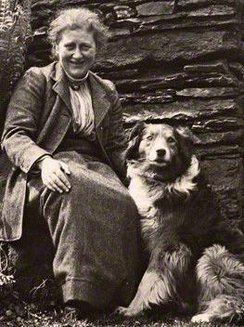
Who is Beatrix Potter?
She was a writer!

Slide 3
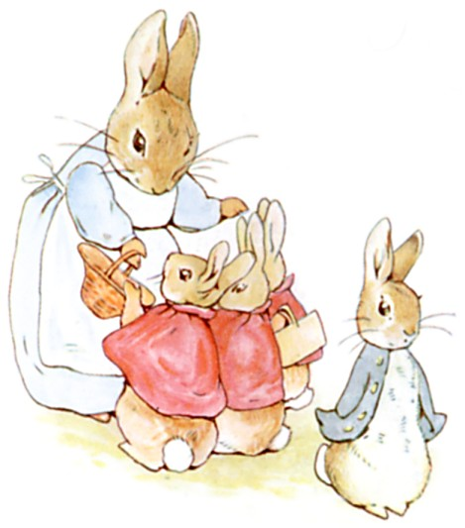
Why is Beatrix famous?
She was an author.
She wrote the tale of Peter Rabbit.

Slide 4
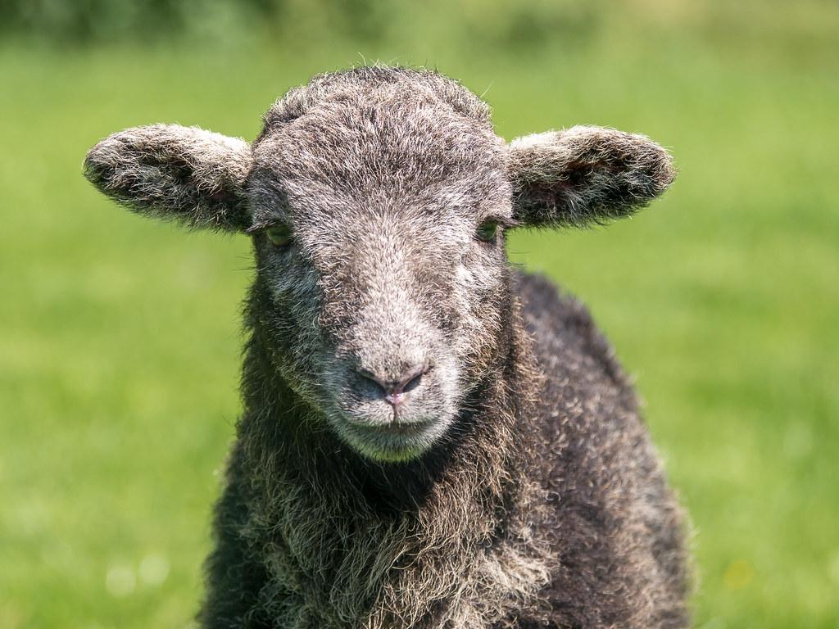
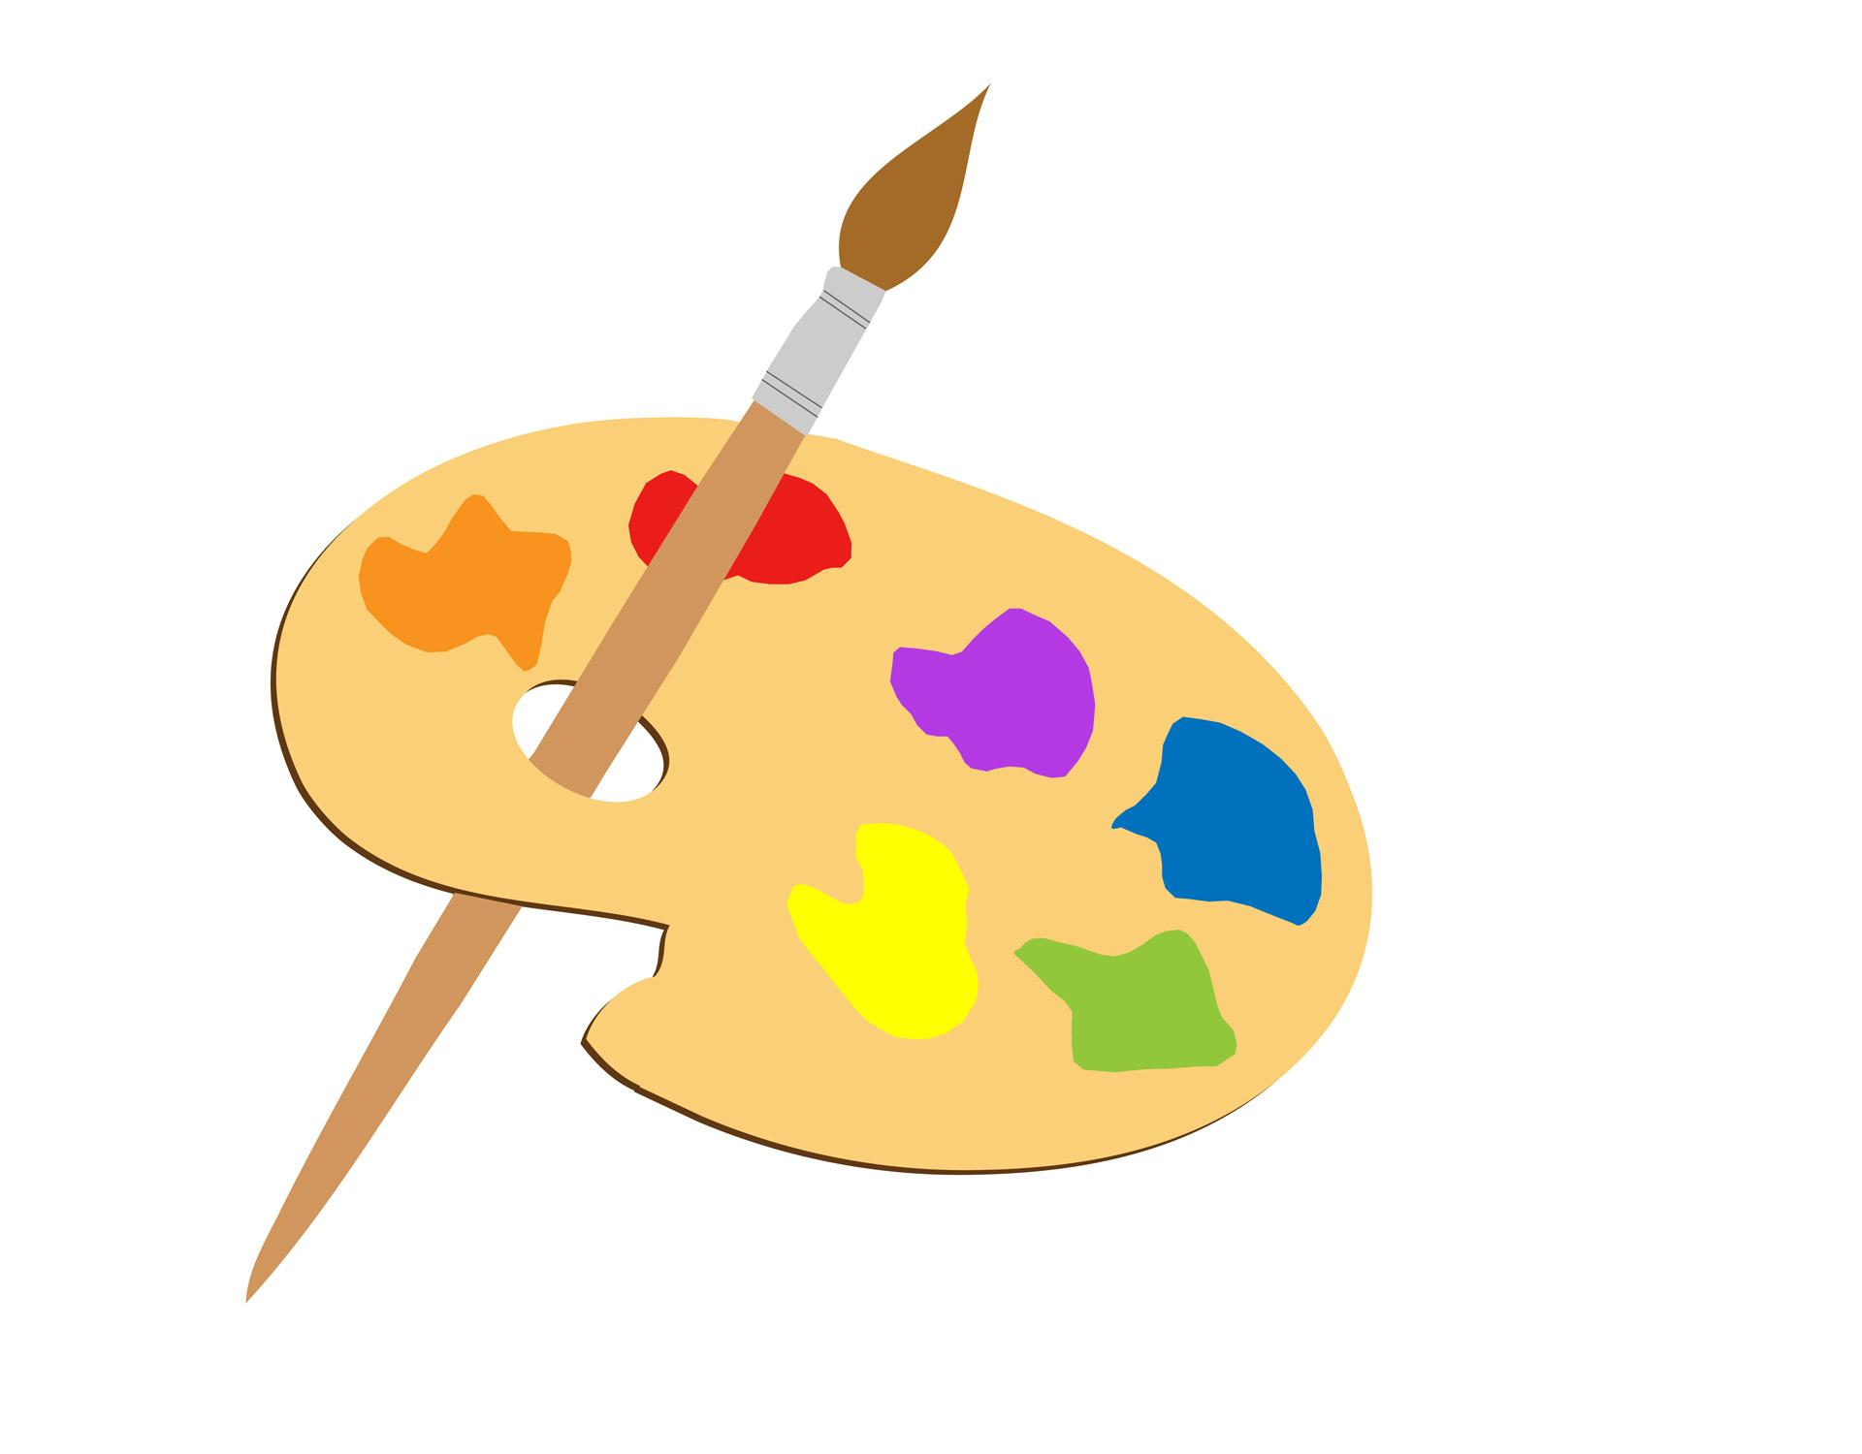
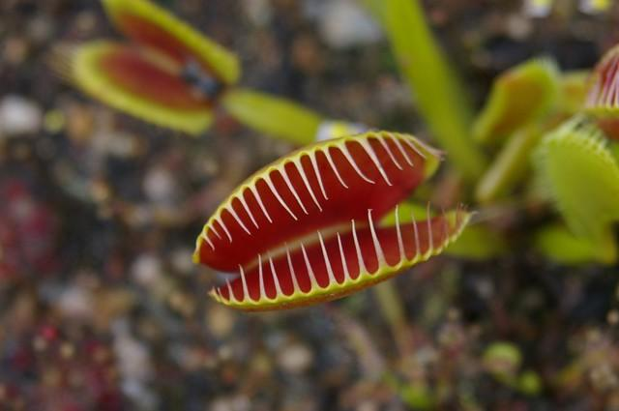
Beatrix’s Favourite Hobbies
Painting,
Studying plants,
Breeding Herdwick sheep.

Slide 5
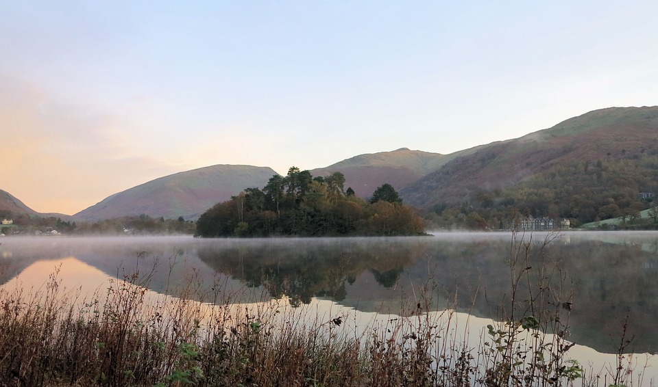
Beatrix Potter`s Childhood
She grew up in London.
She had lots of pets.
She never went to school.
She spent holidays in Scotland ans the Lake District.

Slide 6
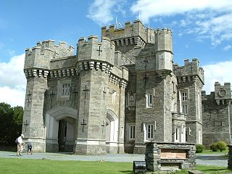
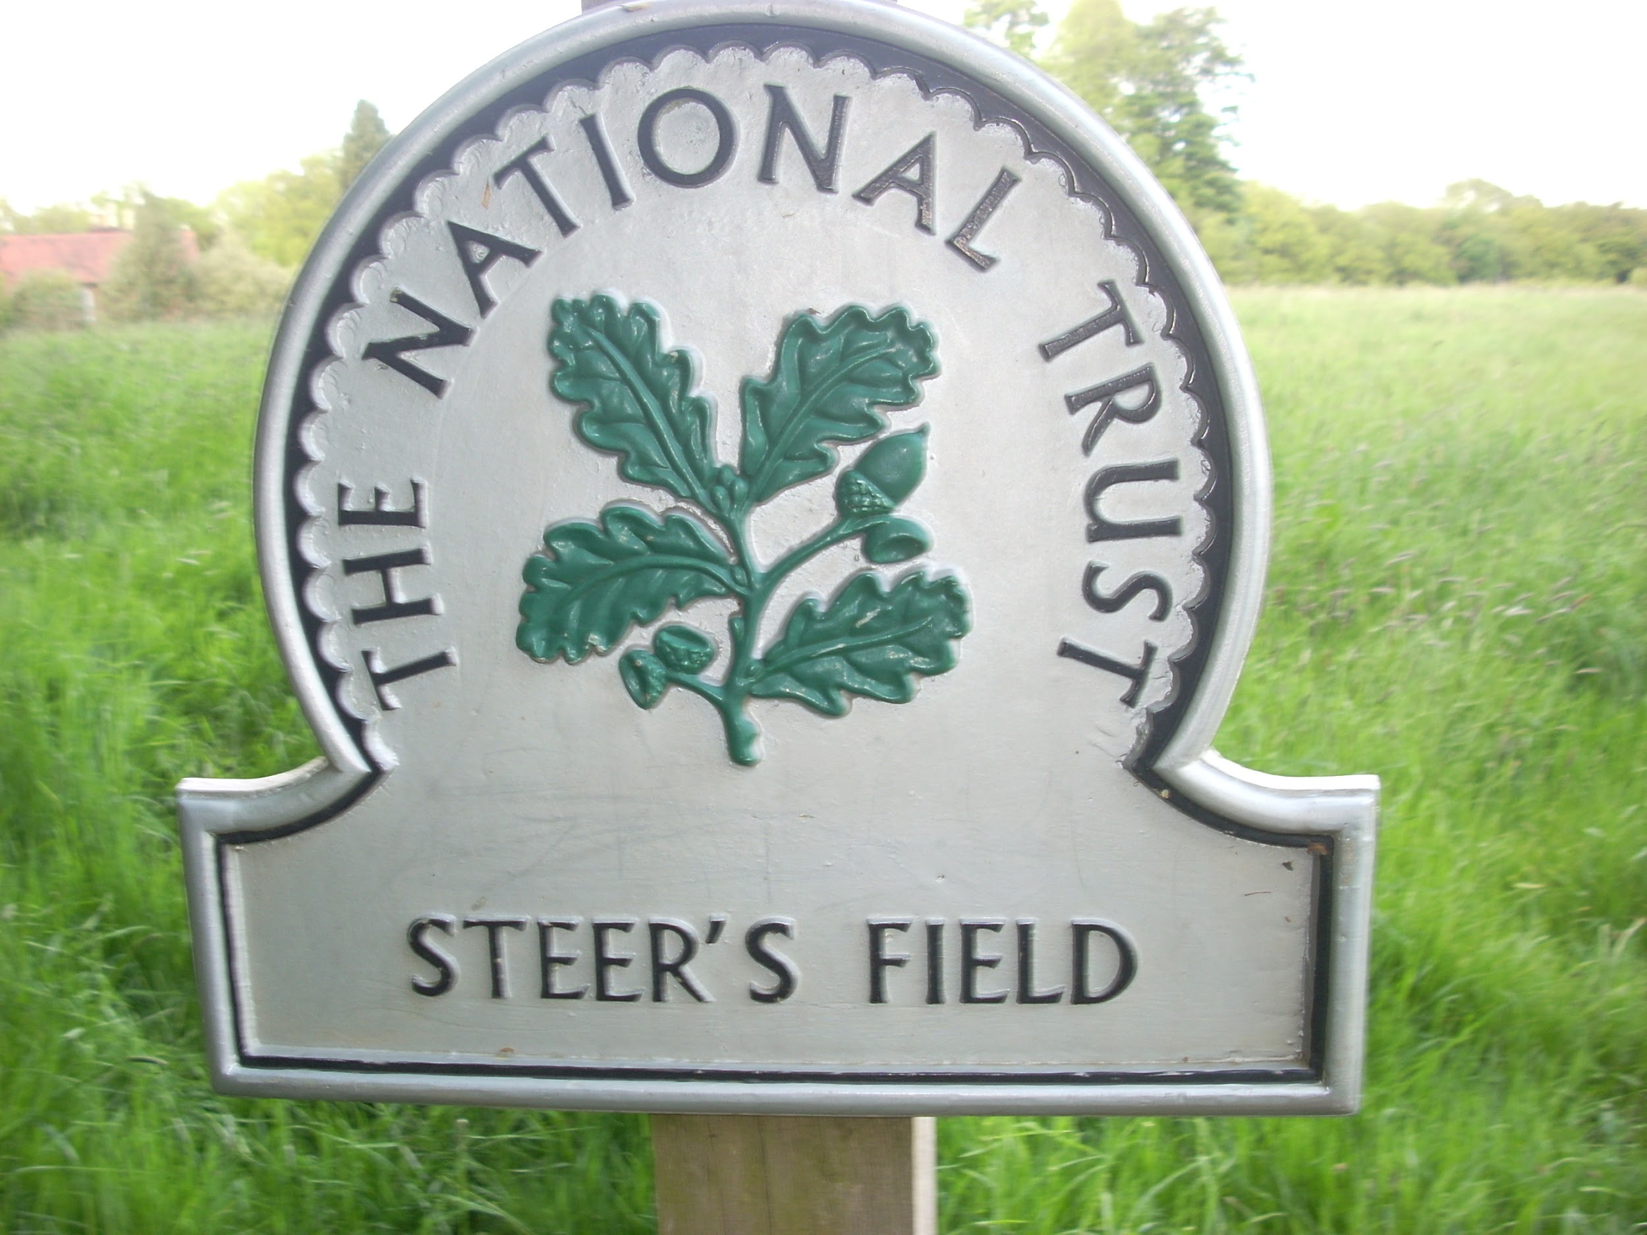
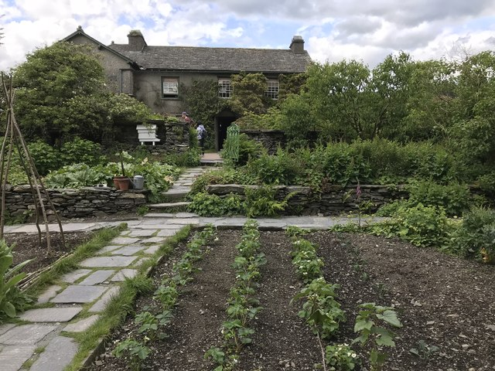
Beatrix`s life
She got married to William Heelis.
She owned 15 farms in the Lake District.
A Supporter of the National Trust.

Slide 7
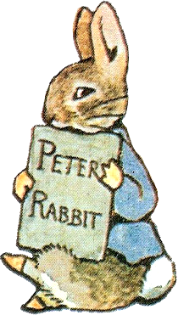
How is Beatrix remembered?
We remember her for her many stories and illustrations.

